Slide 1
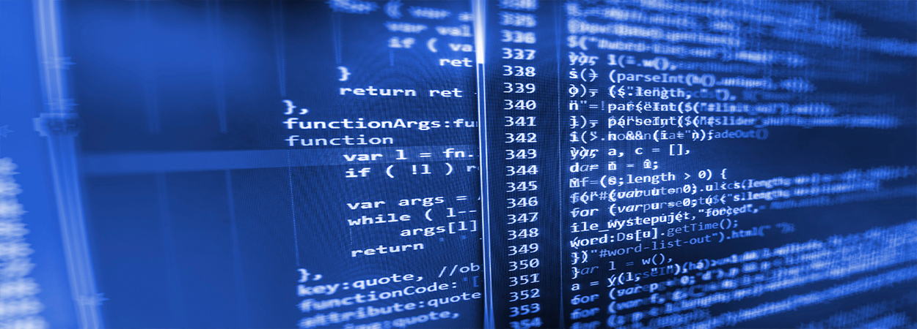
Burn wound healing model
Mark de Boer
Ben Dickens

Slide 2
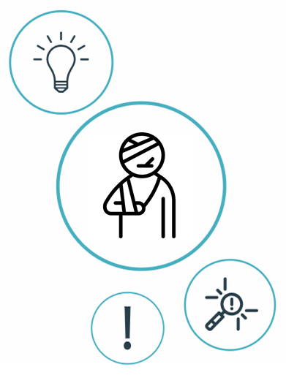
Index
Introduction
Previously built models
Proposal
Possible biomarkers
Possible sociomarkers
Data available?

Slide 3
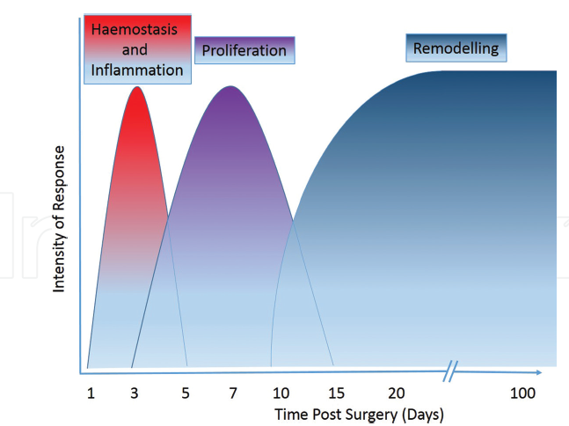
Stages of healing
4 Stages
When a patient comes in, they are likely to have gone through the first stage of response.
Inflammatory response is fundamental to the healing process -> scarring

Slide 4
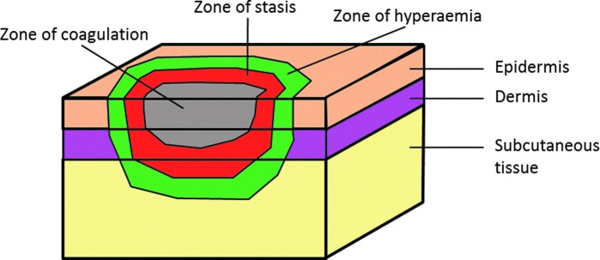
Zones of injury
Burns consist of three zones of injury
Main difference from cuteanous wounds is the the loss of the skin appendages and re-epithelialization, which can only occur from the edges of the wound.

Slide 5
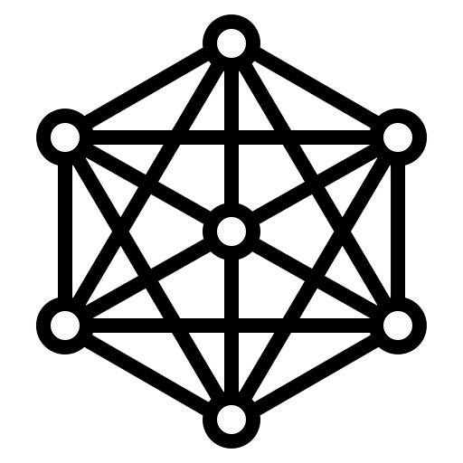
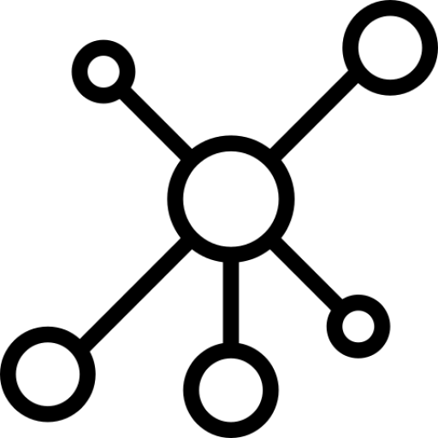
Previously built models
Dynamic ABM/EBM computational frameworks simulating
cutaneous wound healing (Inflammation, Proliferation, Remodeling)
Dynamic EBM computational Alkaline Phosphatase (AP) models
to study the immune response process in wound healing.
Notes:
Perfect skin regeneration of burn wounds remains a challenge. There is still a lack of fundamental understanding of the interactions between different cell types, complex cell signalling networks and mechanical feedback loops during the wound healing process. Previous efforts have focused on constructing dynamic computational frameworks simulating cutaneous wound healing [1,2,3], but have not focused on burn wound healing.
In addition, dynamic computational models have been used to study the inflammation process in wound healing. Presbitero et al. [4] constructed a validated numerical systemic inflammation model under clinical treatment conditions of the Alkaline Phosphatase enzyme. Alkaline phosphatase (AP) exhibits anti-inflammatory effects by dephosphorylating inflammation triggering moieties (ITMs) like bacterial lipopolysaccharides and extracellular nucleotides.
These models are all not burn wound specific, therefore adjustments or an expansion of these models are demanded, to simulate the burn wound procedure. The link between the AP model and the cutaneous wound healing models, has not been investigated/found yet. By first performing a literature review focused on possible connections, this will be investigated. Constructing a computational model simulating burn wound healing would be a step forward towards a better understanding of dynamical adaptation to heal burn wounds.
ABM: simulating the actions and interactions of autonomous agents (both individual or collective entities such as organizations or groups) with a view to assessing their effects on the system as a whole

Slide 6
ABM
EBM
Simulating the actions and interactions of autonomous agents
Behaviors through which individuals interact with one another.
Discrete
Set of equations that expresses relationships among observables:
Time-varying ordinary differential equations (ODE)
Space- time varying partial differential equations (PDE)
Continuous
Notes:
ABM: (both individual or collective entities such as organizations or groups) with a view to assessing their effects on the system as a whole
Although epidemiological ABMs and EBMs share common
goals, they differ in how they model the fundamental
relationships among entities and attention to the level-of-
detail. Both approaches operate in a world that includes
entities and observables tracked over a temporal period.
Observables within the models are measurable characteristics
of actionable interest.

Slide 7
Flegg et al. ~
On the mathematical modeling of wound healing angiogenesis
Boon et al. ~
A multi-agent cell-based model for wound contraction
Tepole et al. ~
Computational modeling of chemo-bio-mechanical
Coupling toward
wound healing
2014
2015
2016
2007
2013
2017
2018
Mi et al. ~
Agent-based model of inflammation and wound healing
Ziraldo et al. ~
Computational Modeling of Inflammation and Wound Healing
Tepole et al. ~
Computational systems mechanobiology of Wound Healing
Sloot et al. ~
Alkaline Phospatase and it’s role in the Immune System

Slide 8
Ziraldo et al. 2013 ~ Computational Modeling of Inflammation and Wound Healing
SPARK-PL (Java)
2-Dimensional ABM model
Inflammation
Including changes in relevant cell populations (Endothelial cells, Macrophages, Neutrophils, and Fibroblasts) and their key effector cytokines (TNF-α, IL-1β, IL-10,and TGF-β1)

Slide 9
Boon et al. 2016 ~ A multi-agent cell-based model for wound contraction
Matlab
3-Dimensional ABM model
Contraction
Including changes in relevant cell populations (leukocytes, fibroblasts, and collagen ) and their key effector cytokines (tPA, PDGF, TGFB)

Slide 10
Tepole et al. 2017 ~ Computational systems mechanobiology of Wound Healing
2-Dimensional EBM model
Proliferation and Remodeling
Modeling Angiogenesis, Contraction and Re-epithelialization
Including changes in relevant cell populations (Endothelial cells, Macrophages, Fibroblasts, Myofibroblasts, Keratinocytes) and their key effector cytokines (TGF-α, FGF-7, PDGF, TGF-β1, FGF(1,2,4), VEGF), and mechanical loads

Slide 11


Research Questions + Aim:
What causes a better healing of burn wounds?
What is the link between the AP model and the cutaneous wound healing model?
A novel computational framework combining the AP and ABM models
to simulate the healing of burn wounds

Slide 12

Proposal
Discrete Spatio-temporal (existing in both space and time) Agent-Based Model combining both the immune response model and the ABM wound healing models
The AP model will act like an engine for the blood composition of a 3-dimensional ABM model.

Slide 13
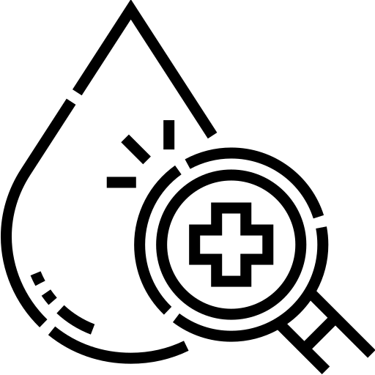
Blood Composition
Pro-inflammatory Cytokines:
IL-8
IL-6
IL-1β
TNF-α
Anti-inflammatory Cytokines
Interleukin 10 (IL-10)
IL-6
TGF-β
Other:
C-reactive protein (CRP)
Leptin
Neutrophils
Macrophages
TGF-α

Slide 14

Relevant parameters/markers
Geometrical Paramaters:
Length
Width
Depth of burn
Surface
Volume
Total Body surface area of burn (TBSA)
Burn Location/s
Relevant Socio-markers
Age
Weight
Height
Gender
Skin type

Slide 15

Data available?

Slide 16

Conclusion

